Slide 1
The Influence of African Culture on Modern Business and Finance

Slide 2
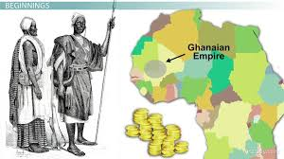
Introduction to African Business Practices
African traditional markets have long been centers of trade and social interaction. In regions like West Africa, open-air markets have been pivotal in driving local economies.
Trade was not only an economic activity but also a cultural practice. Barter systems, communal wealth-sharing, and clan-based trading networks shaped many African economies.
Key point: Traditional African business practices were built on relationships, trust, and community, different from modern, contract-based global trade.

Slide 3
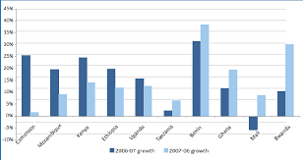
Cultural Influence on Modern African Entrepreneurship
Entrepreneurship in many African cultures is driven by communal responsibility. African business owners often focus on supporting extended families or contributing to community welfare.
Microfinance institutions (MFIs) in Africa draw inspiration from communal savings practices like "stokvels" in South Africa or "merry-go-rounds" in Kenya, where community members pool resources to support each other.
Key point: African cultural values of solidarity and cooperation have shaped the development of innovative financial tools like microfinance.

Slide 4
Traditional Trade and Its Legacy in Modern Business
Pre-colonial trade routes, such as the Trans-Saharan Trade and Indian Ocean Trade, created vast networks that influenced African economies. Commodities like gold, salt, and ivory were traded across regions.
The legacy of these ancient trade networks continues to impact African business practices today, particularly in sectors like import/export and international trade.
Key point: Africa’s historical trade relationships set the foundation for global business connections that are still relevant today.

Slide 5

Role of Culture in Corporate Governance and Leadership
In African societies, leadership was often viewed as a duty to serve the community, a concept mirrored in Ubuntu, the philosophy of interdependence and communal responsibility.
Modern African corporate governance is increasingly incorporating cultural elements like inclusivity, stakeholder engagement, and ethical leadership, derived from traditional practices.
Key point: African culture promotes ethical leadership and governance, influencing corporate responsibility frameworks in business.

Slide 6
Challenges and Opportunities in African Business Environments
African culture encourages entrepreneurship but also faces challenges like informal business practices and regulatory hurdles.
Efforts to formalize African businesses and integrate cultural practices with modern economic systems present opportunities for sustainable growth.
Key point: By combining African cultural values with formalized business practices, Africa can create unique models of economic success.

Slide 7

Case Study: African Business Models in the Global Market
Example: The success of mobile banking platforms like M-Pesa in Kenya, which expanded financial inclusion by building on community trust and local business practices.
Example: Made-in-Rwanda campaigns emphasize cultural pride, supporting local entrepreneurs and promoting African-made products in the global market.
Key point: African business models that incorporate cultural values are finding global success, showing the viability of culture-based innovation.

Slide 8
Conclusion
African culture plays a vital role in shaping business and finance practices, offering unique perspectives that can contribute to sustainable economic growth.
The integration of African cultural values in leadership, corporate governance, and entrepreneurship holds potential for creating more inclusive and community-centered financial systems.

